Slide 1
Chapter 6
THE NORMAL CURVE, STANDARDIZATION, AND Z SCORES

Slide 2
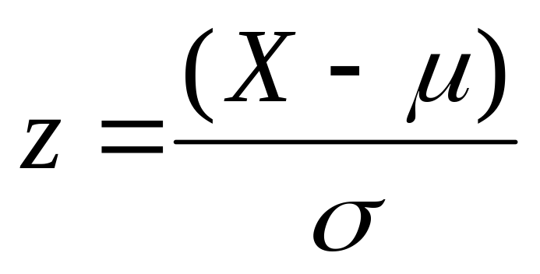
Z-scores
Transformation of raw score that reflects number of standard deviations above/below the mean
Any score on any measure can be converted to the z distribution

Slide 3
How do we calculate z-scores?
X – μ
5 – 12.61
= -2.12
z =
z =
σ
3.59
5 7 7 7 7 7 8 8 9 10 10 10 10 10… 16 16 17 17 17 17 17 18 20
µ= 12.61
σ= 3.59
Notes:
For population, use mu and sigma (population standard deviation)

Slide 4
How do we calculate z-scores?
X – μ
5 – 12.61
= -2.12
z =
z =
σ
3.59
Sign tells us if it’s above or below mean
Value tells us how many standard
deviations from mean it is
Notes:
Don’t want to calculate new frequency distribution for all samples

Slide 5
Using z scores to Make Comparisons
Allows us to compare raw scores from different distributions
Who is the better student?
  Jack has a GPA of 3.6 at University A (μ = 2.98, σ = 0.47)
  Leo has a GPA of 3.7 at University B (μ = 2.66, σ = 0.42)

Slide 6

Jack or Leo?
X – μ
3.6 – 2.98
= 1.32
z =
z_{J} =
σ
0.47
3.7 – 2.66
= 2.48
z_{L} =
Leo
0.42
Notes:
For population, use mu and sigma (population standard deviation)

Slide 7
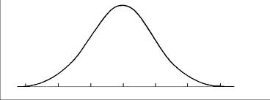
The Normal Curve
Specific, bell-shaped curve
  unimodal
  symmetric
  defined mathematically

Slide 8
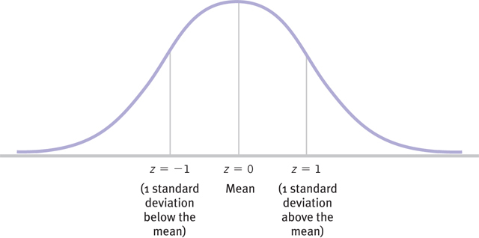
The Normal Curve (z Distribution)
Mean = 0
Standard Deviation = 1

Slide 9
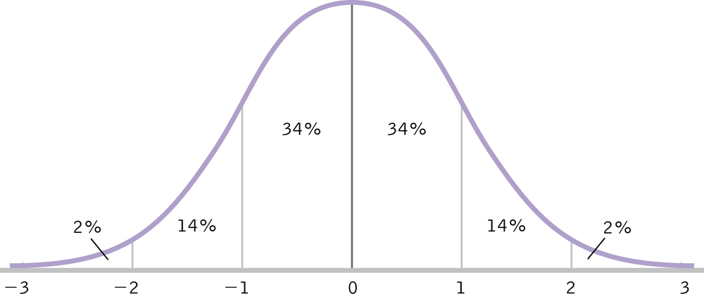
z Scores and Percentiles
z scores place a score relative to its population
z scores allow us to compare scores from different populations
z scores can be transformed into percentiles

Slide 10
Jack; z = 1.32
Leo; z = 2.48

Slide 11
Sampling Distribution
Distribution of a particular statistic calculated for many samples (size N)
Typically, interested in the sampling distribution of the mean

Slide 12
Sampling Distribution
Mean of the sampling distribution
  Equal to μ (mean of the population)
  μ_{M}
Standard deviation of the sampling distribution
  Smaller than σ (standard deviation of the population)
  Standard error
  σ_{M}
σ_{M}=
σ
√ N

Slide 13
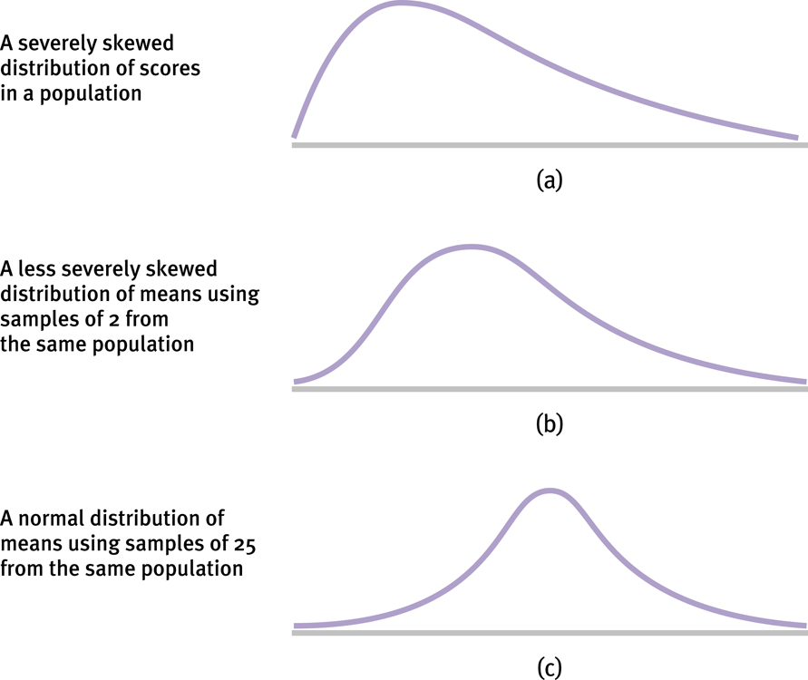
Central Limit Theorem
Even if the population is skewed, the distribution of the means will approximate the normal curve (N ≥ 30)

Slide 14
Inferential Statistics
Combine
  Sampling distribution of the mean
  Normal curve (z scores)
… and we can determine the relative placement of a particular sample mean

Slide 15
Example
IQ scores: μ = 100; σ = 15
IV: brain “exercises” for 3 months
N = 90
M = 102
M – μ_{M}
102 – 100
= 1.27
z =
z =
σ_{M}
1.58

